Slide 1
Introduction to Computational Thermodynamics
Section 3.3
Chemical Stability Analysis

Slide 2
Introduction
Stability analysis deals with the question “does a phase-split occur?”
This helps us determine if a single-phase solution is correct, or if further calculation is necessary
If further calculation is required, stability analysis can provide good initial guesses

Slide 3
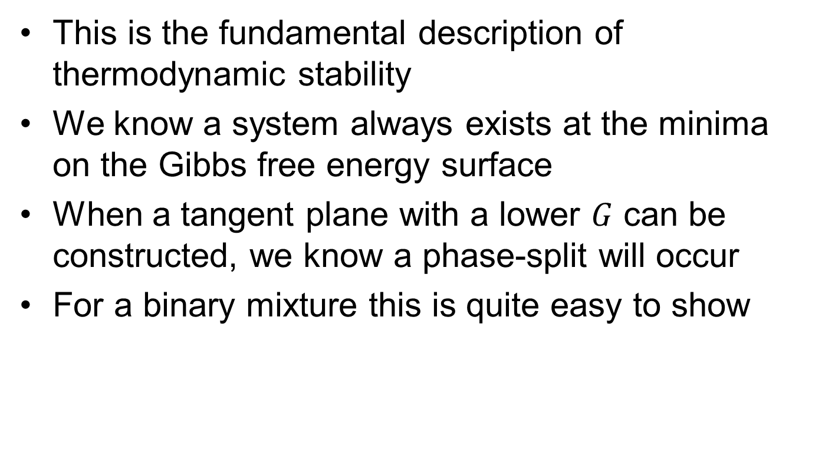
The Gibbs tangent-plane
This is the fundamental description of thermodynamic stability
We know a system always exists at the minima on the Gibbs free energy surface
When a tangent plane with a lower $G$ can be constructed, we know a phase-split will occur
For a binary mixture this is quite easy to show

Slide 4
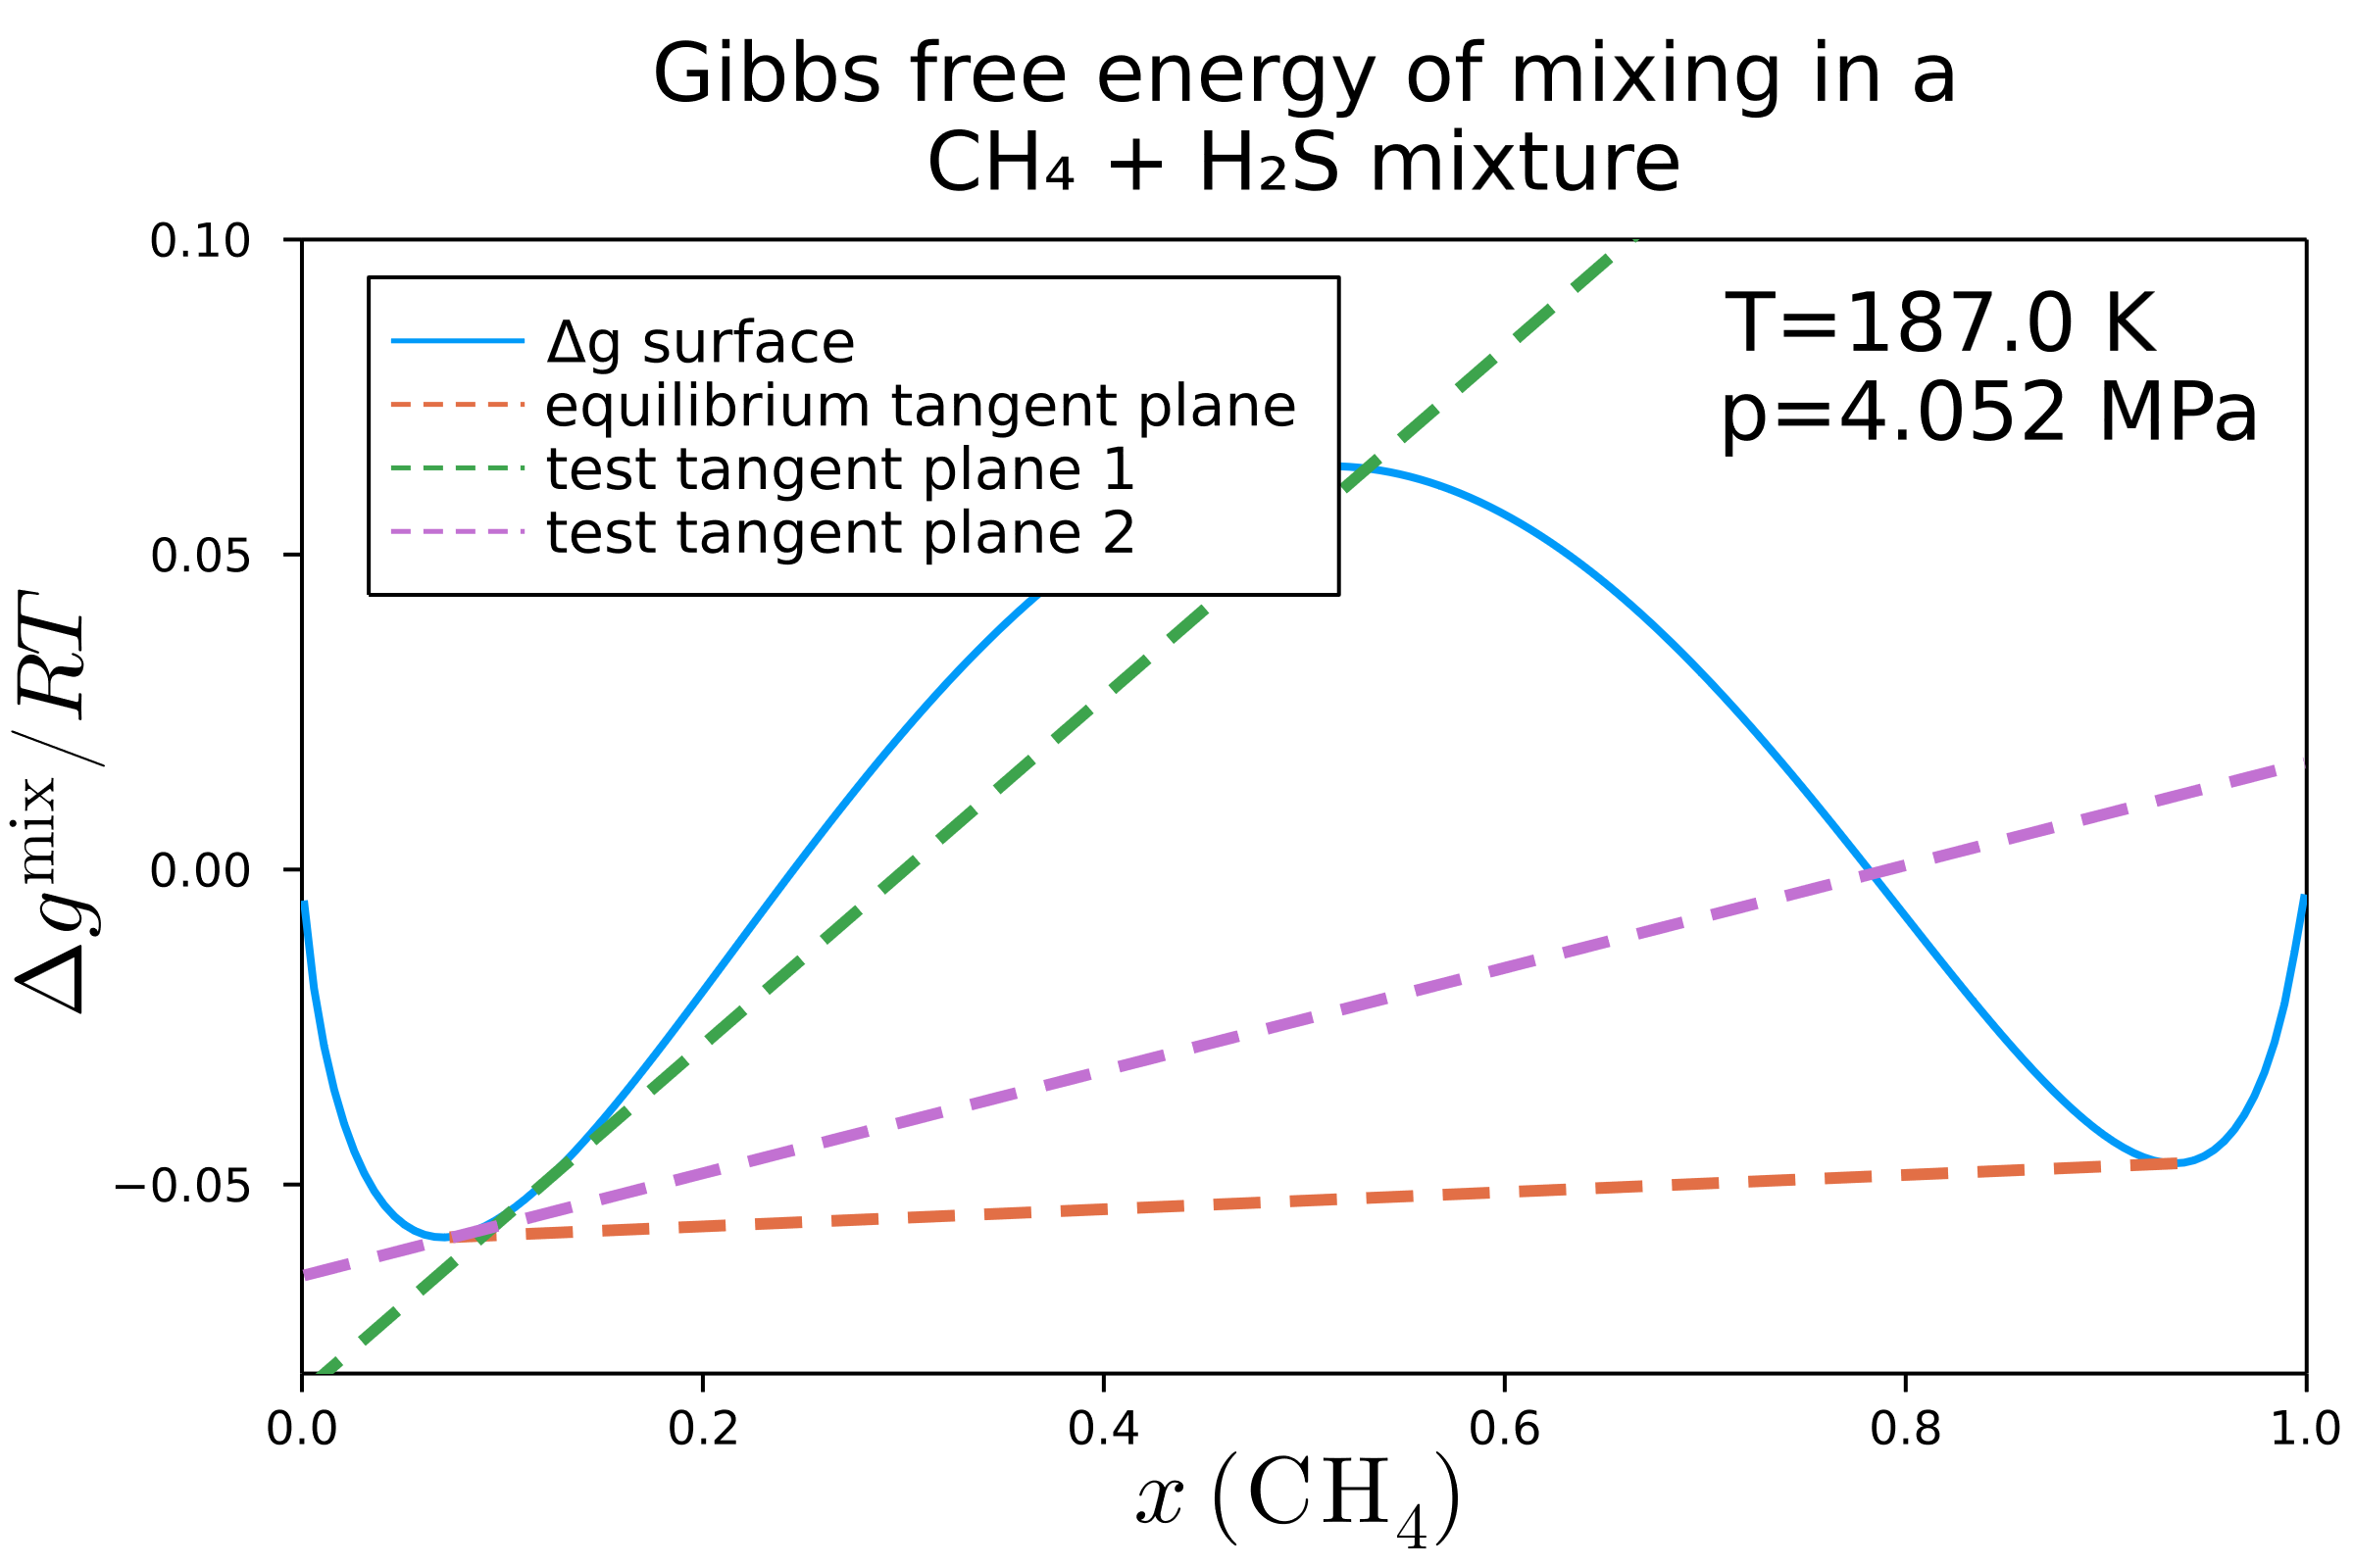
The Gibbs tangent-plane
Any plane tangent at one point signifies instability
However, there is only one cotangent plane – this shows the resulting phase split compositions

Slide 5
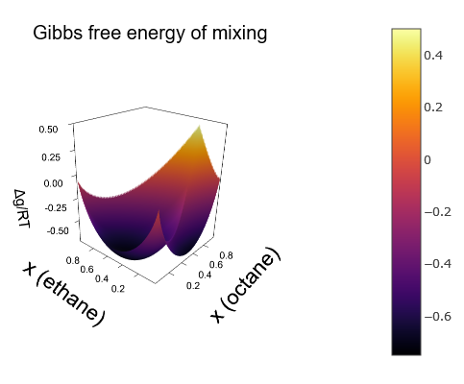
The Gibbs tangent-plane
If we look at a ternary mixture of ethane, octane, and propane it becomes far harder to see where exactly the phase split occurs

Slide 6
Mathematical description
To implement this on a computer, we need a mathematical description of instability

Slide 7

Mathematical description
To implement this on a computer, we need a mathematical description of instability
Following the description from Michelsen, this can be motivated by considering the Gibbs free energy ($G$) must be at a global minimum

Slide 8
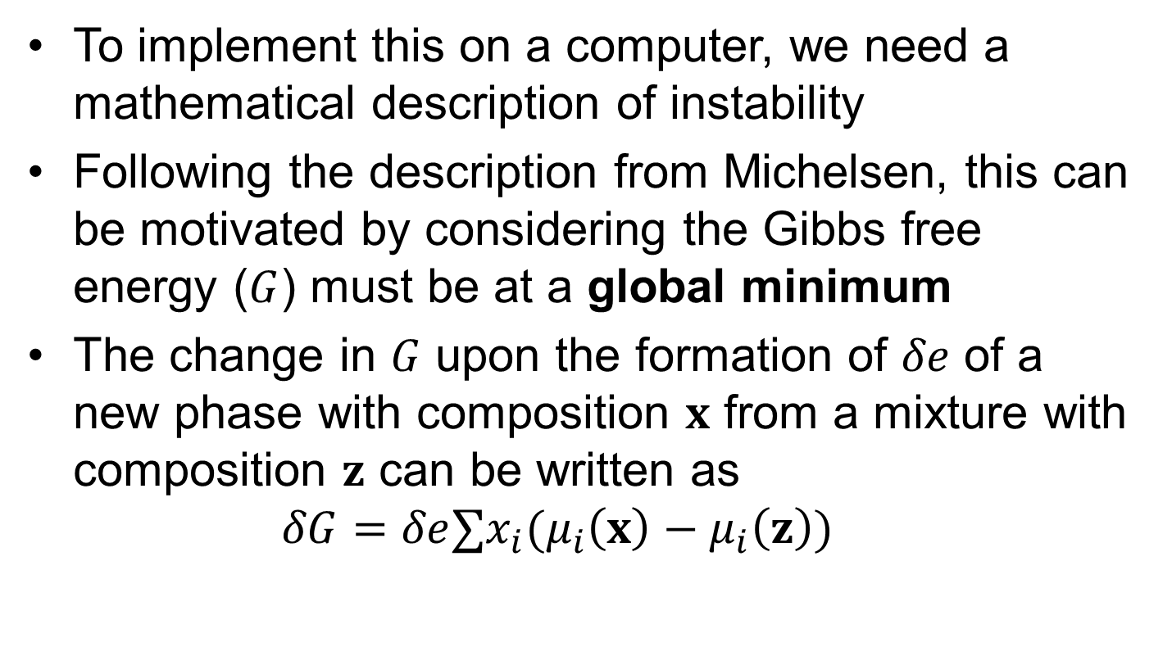
Mathematical description
To implement this on a computer, we need a mathematical description of instability
Following the description from Michelsen, this can be motivated by considering the Gibbs free energy ($G$) must be at a global minimum
The change in $G$ upon the formation of $δe$ of a new phase with composition $x$ from a mixture with composition $z$ can be written as $δG=δe∑x_{i}(μ_{i}\left(x\right)−μ_{i}\left(z\right))$

Slide 9
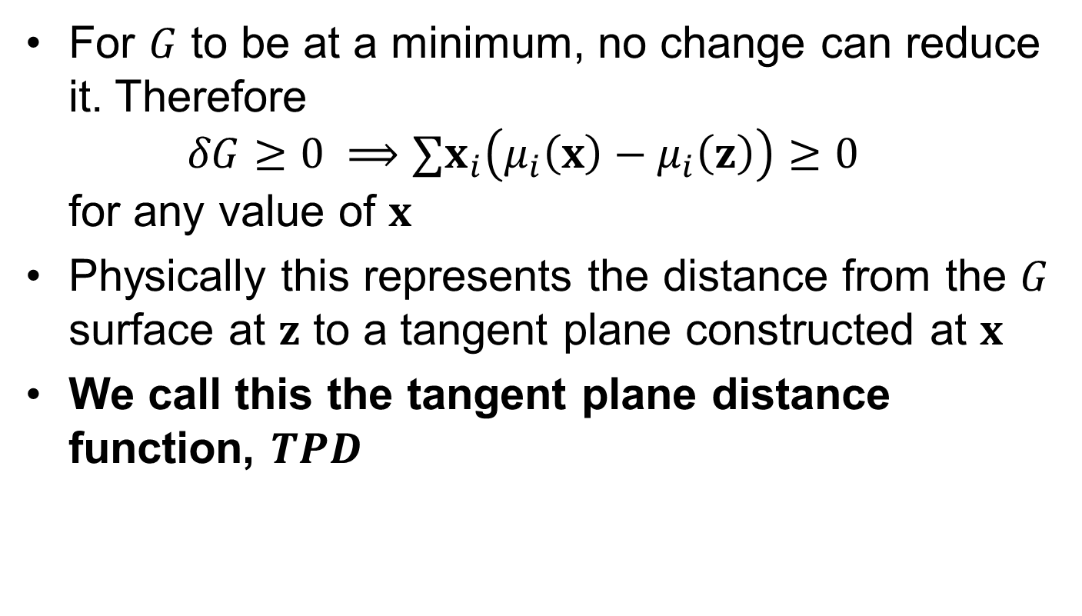
Mathematical description
For $G$ to be at a minimum, no change can reduce it. Therefore $δG≥0 ⟹∑x_{i}\left(μ_{i}\left(x\right)−μ_{i}\left(z\right)\right)≥0$ for any value of $x$
Physically this represents the distance from the $G$ surface at $z$ to a tangent plane constructed at $x$
We call this the tangent plane distance function, $TPD$

Slide 10
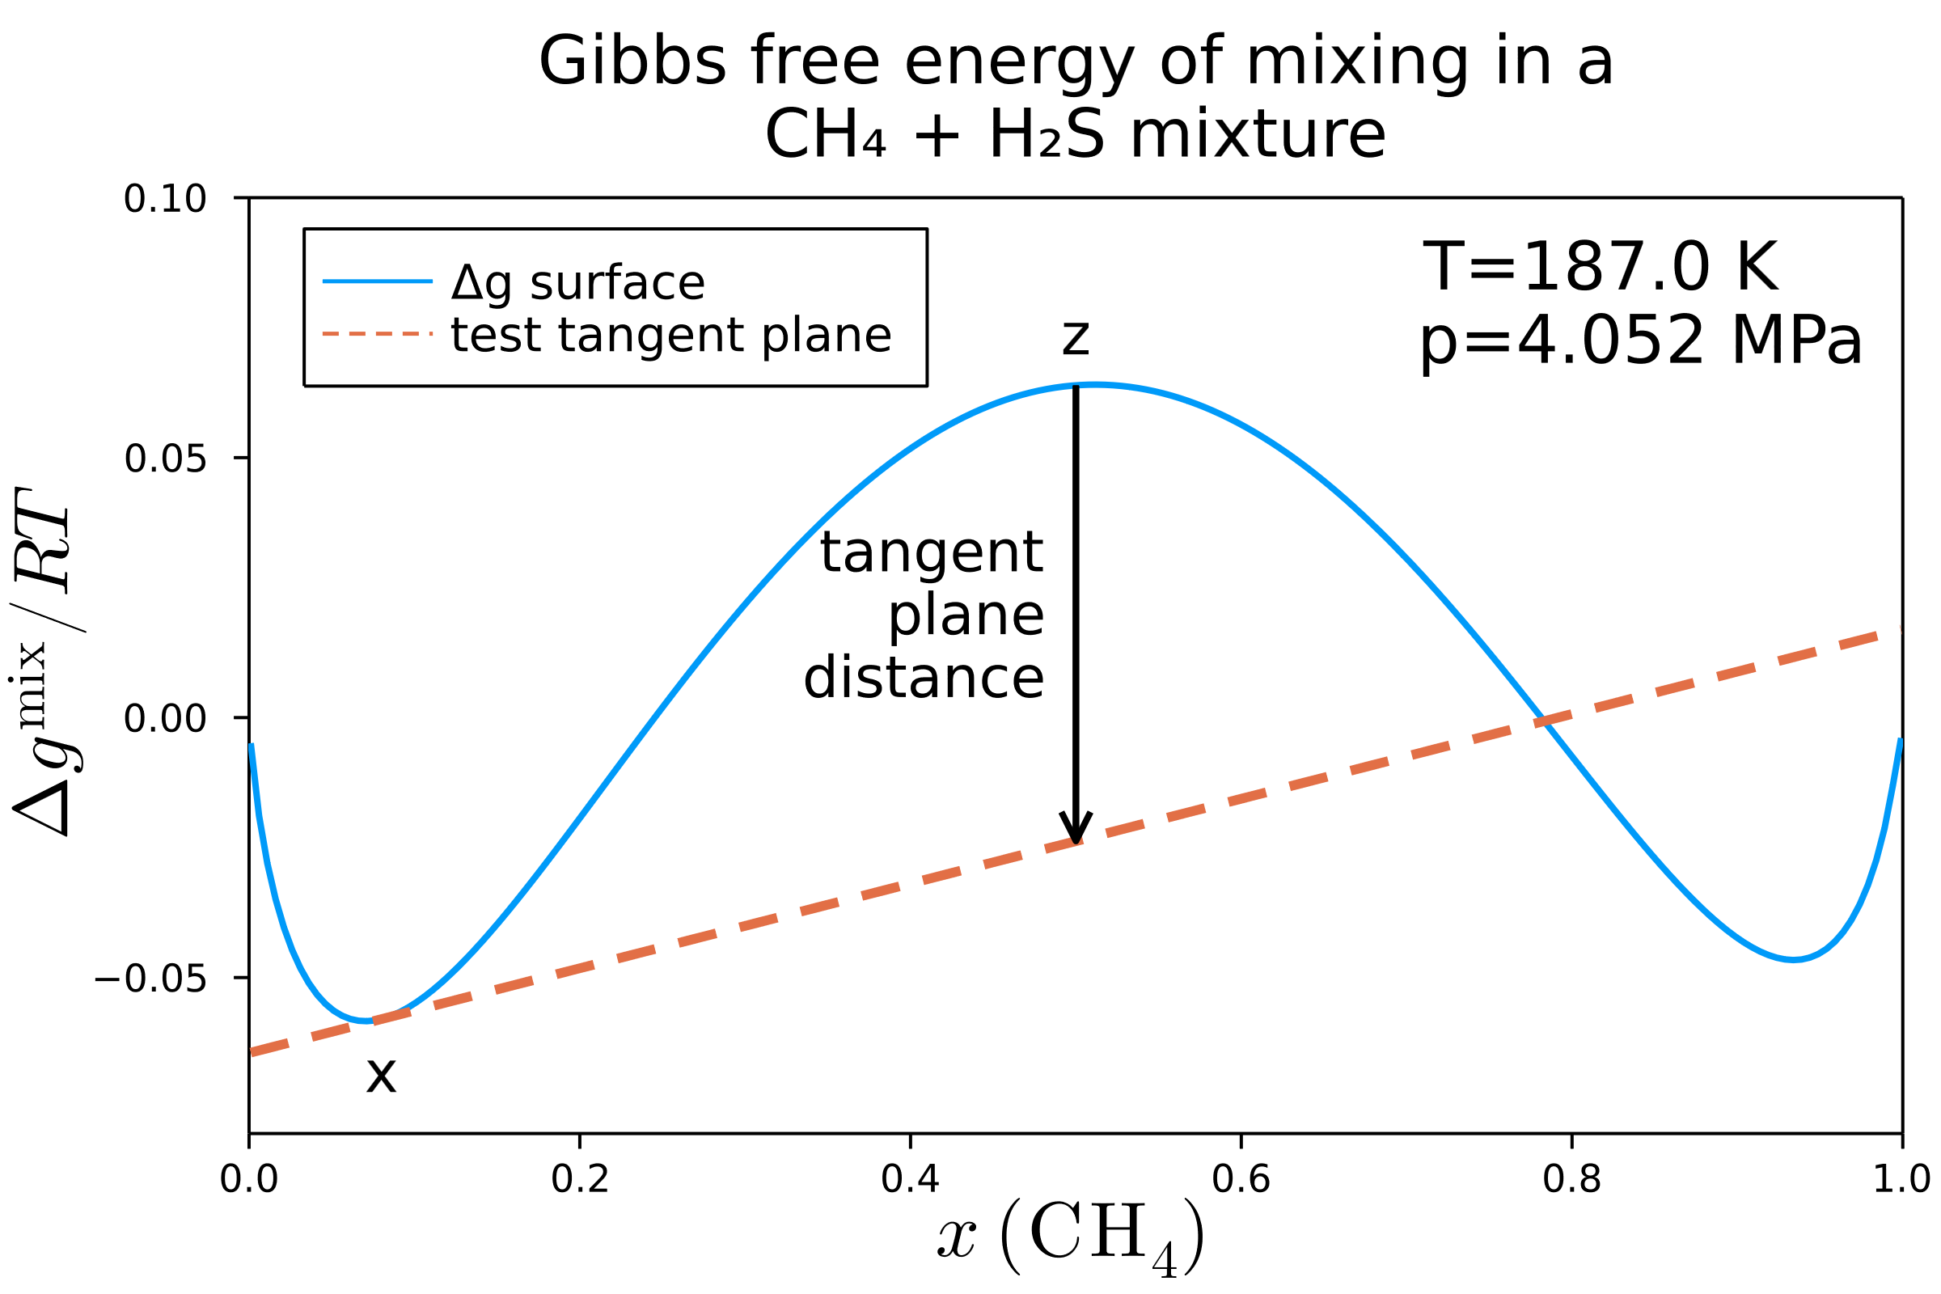

Mathematical description
Our function describing chemical stability is then $TPD\left(x\right)=∑x_{i}\left(μ_{i}\left(x\right)−μ_{i}\left(z\right)\right)$

Slide 11
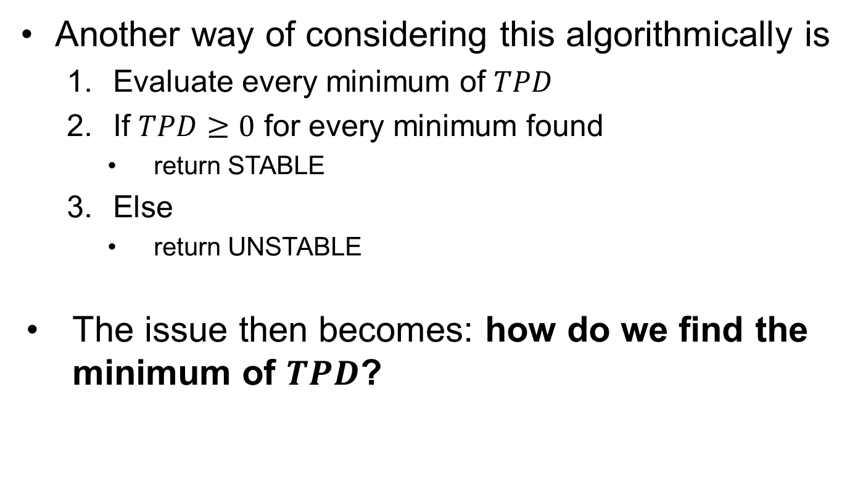
Mathematical description
Another way of considering this algorithmically is
Evaluate every minimum of $TPD$
If $TPD≥0$ for every minimum found
return STABLE
Else
return UNSTABLE
The issue then becomes: how do we find the minimum of $TPD$?

Slide 12
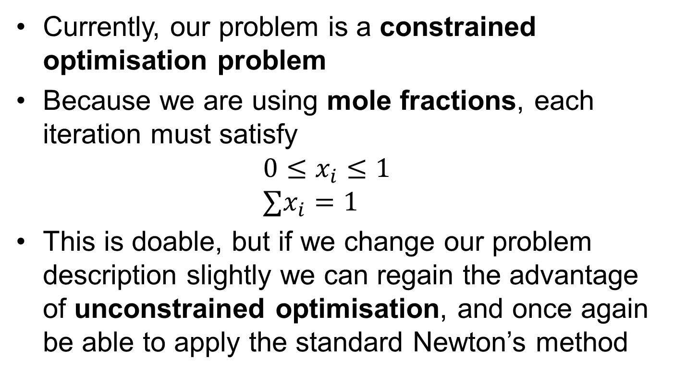
Numerical issues
Currently, our problem is a constrained optimisation problem
Because we are using mole fractions, each iteration must satisfy $0≤x_{i}≤1$ $∑x_{i}=1$
This is doable, but if we change our problem description slightly we can regain the advantage of unconstrained optimisation, and once again be able to apply the standard Newton’s method

Slide 13
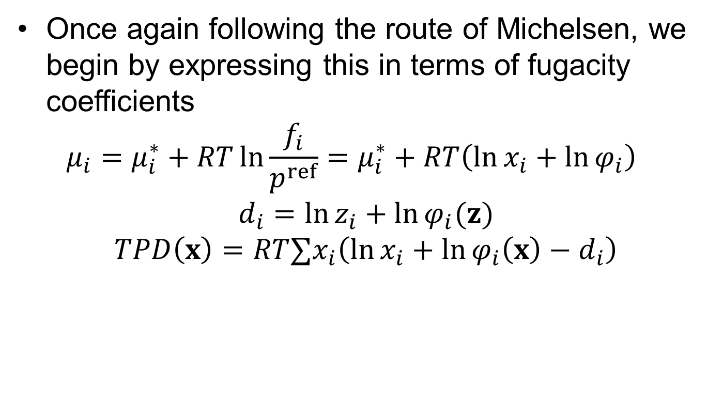
Improved formulation
Once again following the route of Michelsen, we begin by expressing this in terms of fugacity coefficients $μ_{i}=μ_{i}^{∗}+RT\ln{\frac{f_{i}}{p^{ref}}}=μ_{i}^{∗}+RT\left(\ln{x_{i}}+\ln{φ_{i}}\right)$
$$d_{i}=\ln{z_{i}+\ln{φ_{i}(z)}} \\ TPD\left(x\right)=RT∑x_{i}\left(\ln{x_{i}}+\ln{φ_{i}\left(x\right)}−d_{i}\right)$$
Notes:
Mu_i^* is the pure component fugacity

Slide 14
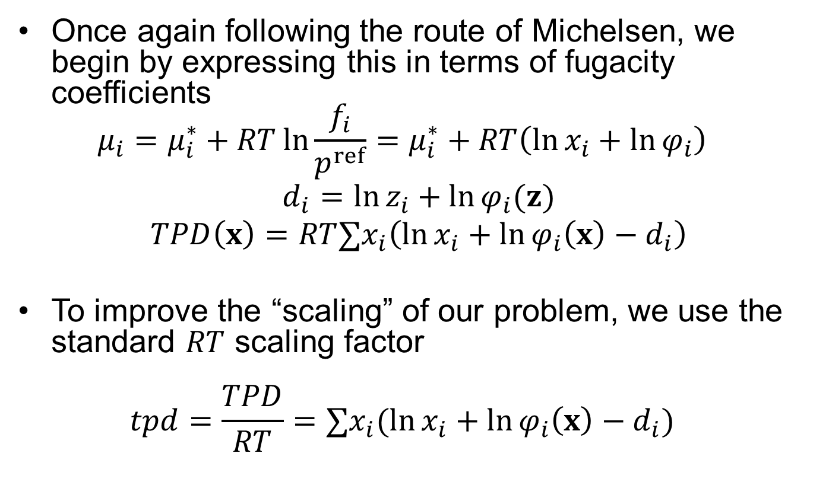
Improved formulation
Once again following the route of Michelsen, we begin by expressing this in terms of fugacity coefficients $μ_{i}=μ_{i}^{∗}+RT\ln{\frac{f_{i}}{p^{ref}}}=μ_{i}^{∗}+RT\left(\ln{x_{i}}+\ln{φ_{i}}\right)$
$$d_{i}=\ln{z_{i}+\ln{φ_{i}(z)}} \\ TPD\left(x\right)=RT∑x_{i}\left(\ln{x_{i}}+\ln{φ_{i}\left(x\right)}−d_{i}\right)$$
To improve the “scaling” of our problem, we use the standard $RT$ scaling factor $tpd=\frac{TPD}{RT}=∑x_{i}(\ln{x_{i}}+\ln{φ_{i}\left(x\right)}−d_{i})$

Slide 15
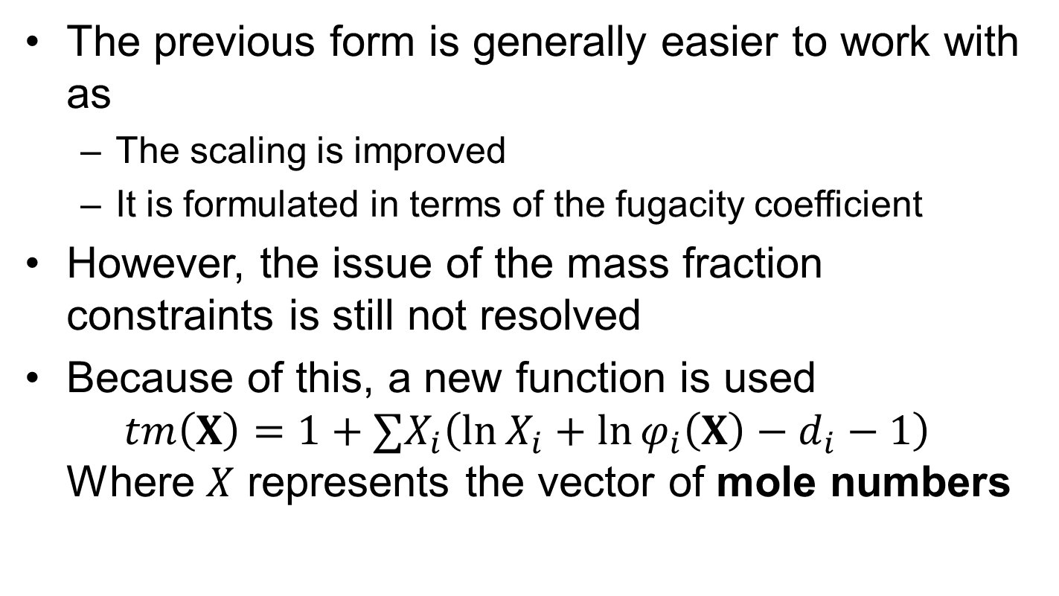
Unconstrained formulation
The previous form is generally easier to work with as
The scaling is improved
It is formulated in terms of the fugacity coefficient
However, the issue of the mass fraction constraints is still not resolved
Because of this, a new function is used $tm\left(X\right)=1+∑X_{i}\left(\ln{X_{i}}+\ln{φ_{i}\left(X\right)}−d_{i}−1\right)$ Where $X$ represents the vector of mole numbers
Notes:
It is important to realise that tm(X) is _not_ the same as tpd, but rather a related but new function turning out to be more convenient

Slide 16
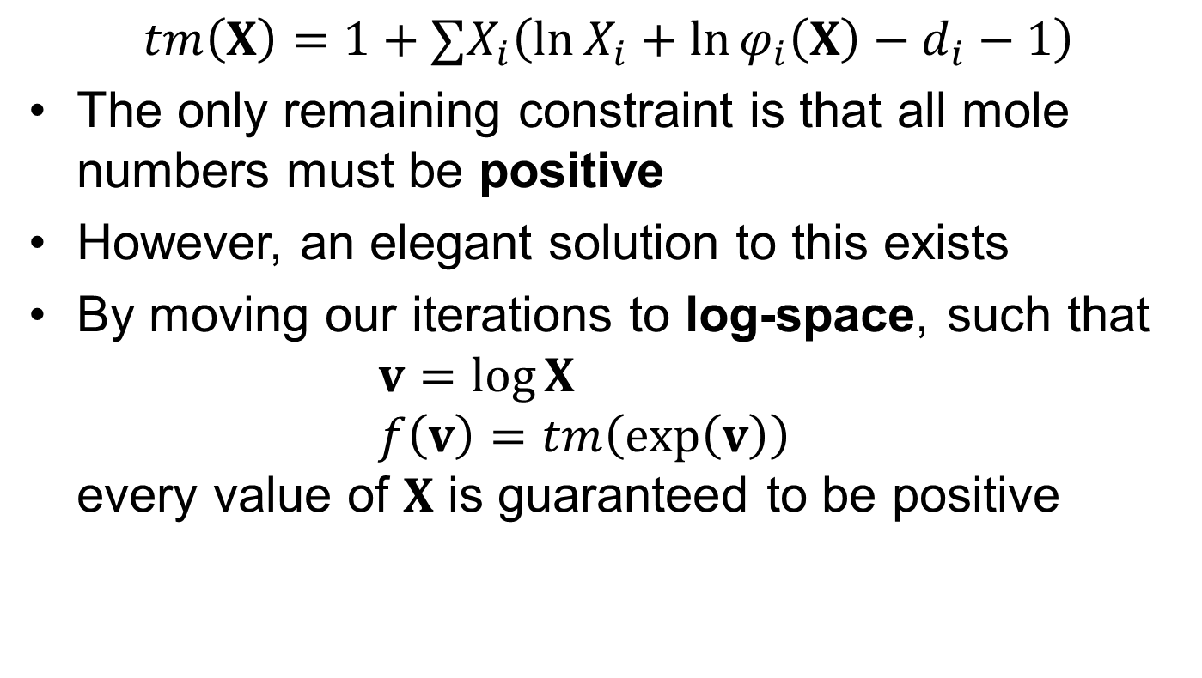
Unconstrained formulation
$$tm\left(X\right)=1+∑X_{i}\left(\ln{X_{i}}+\ln{φ_{i}\left(X\right)}−d_{i}−1\right)$$
The only remaining constraint is that all mole numbers must be positive
However, an elegant solution to this exists
By moving our iterations to log-space, such that $v=\log{X}$ $f\left(v\right)=tm\left(\exp\left(v\right)\right)$ every value of $X$ is guaranteed to be positive

Slide 17
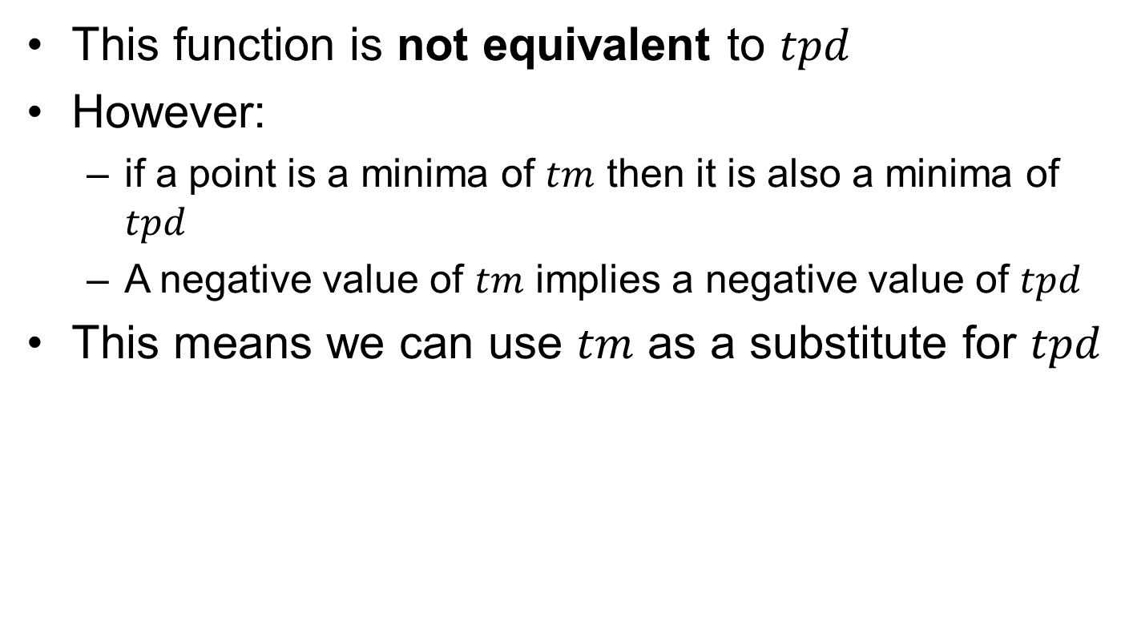
Unconstrained formulation
This function is not equivalent to $tpd$
However:
if a point is a minima of $tm$ then it is also a minima of $tpd$
A negative value of $tm$ implies a negative value of $tpd$
This means we can use $tm$ as a substitute for $tpd$

Slide 18
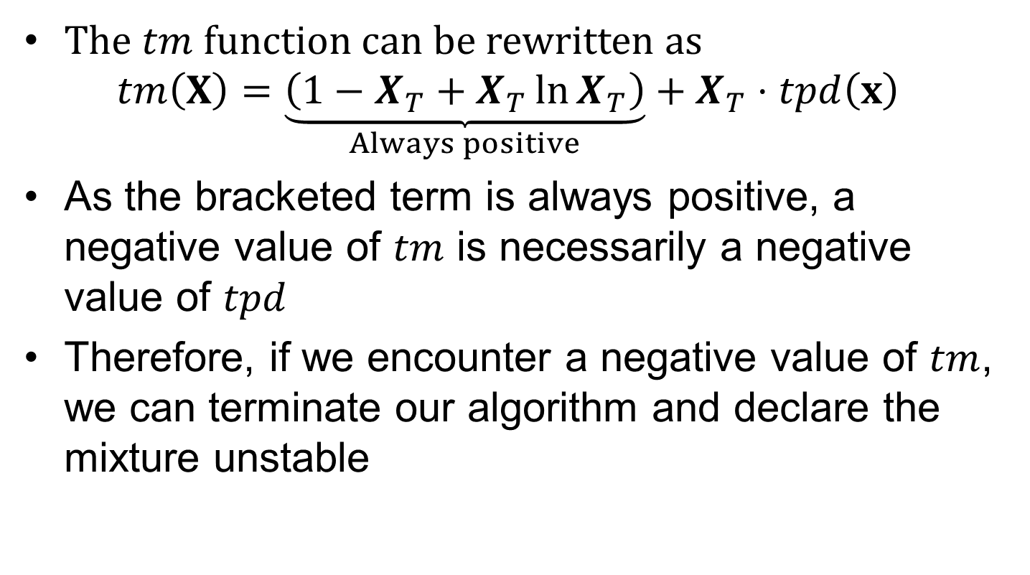
Unconstrained formulation
The $tm$ function can be rewritten as
$$tm\left(X\right)=\underset{Always positive}{\underbrace{\left(1−X_{T}+X_{T}\ln{X_{T}}\right)}}+X_{T}⋅tpd\left(x\right)$$
As the bracketed term is always positive, a negative value of $tm$ is necessarily a negative value of $tpd$
Therefore, if we encounter a negative value of $tm$, we can terminate our algorithm and declare the mixture unstable

Slide 19
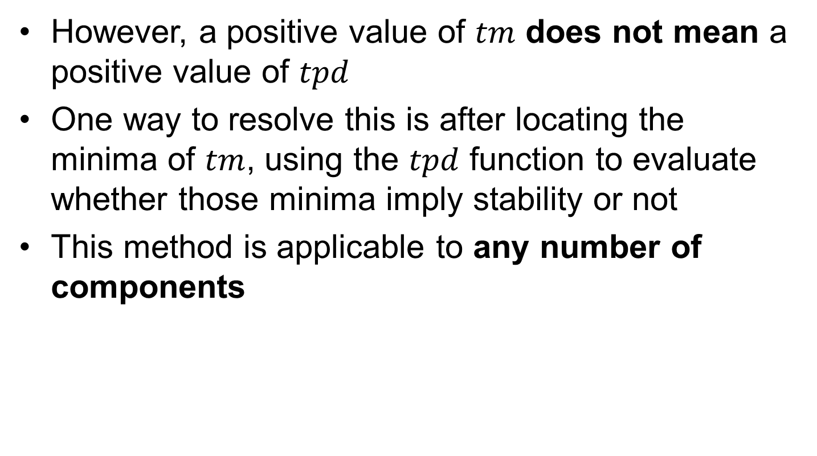
Unconstrained formulation
However, a positive value of $tm$ does not mean a positive value of $tpd$
One way to resolve this is after locating the minima of $tm$, using the $tpd$ function to evaluate whether those minima imply stability or not
This method is applicable to any number of components

Slide 20

Implementation
We will split the implementation into three stages:
Specify state and model
Generate initial guesses
Minimise objective function $tm$

Slide 21
1. State and model specification
For a phase split to occur, we must have non-ideal mixing
To capture this, we must have a prediction for the binary interaction parameters
I have chosen the Extended Predictive Peng Robinson-78 (EPPR78)

Slide 22
1. State and model specification
For a phase split to occur, we must have non-ideal mixing
To capture this, we must have a prediction for the binary interaction parameters
I have chosen the Extended Predictive Peng Robinson-78 (EPPR78)
For our mixture we use methane and hydrogen sulfide evaluated at 187 K, 4.052 MPa

Slide 23
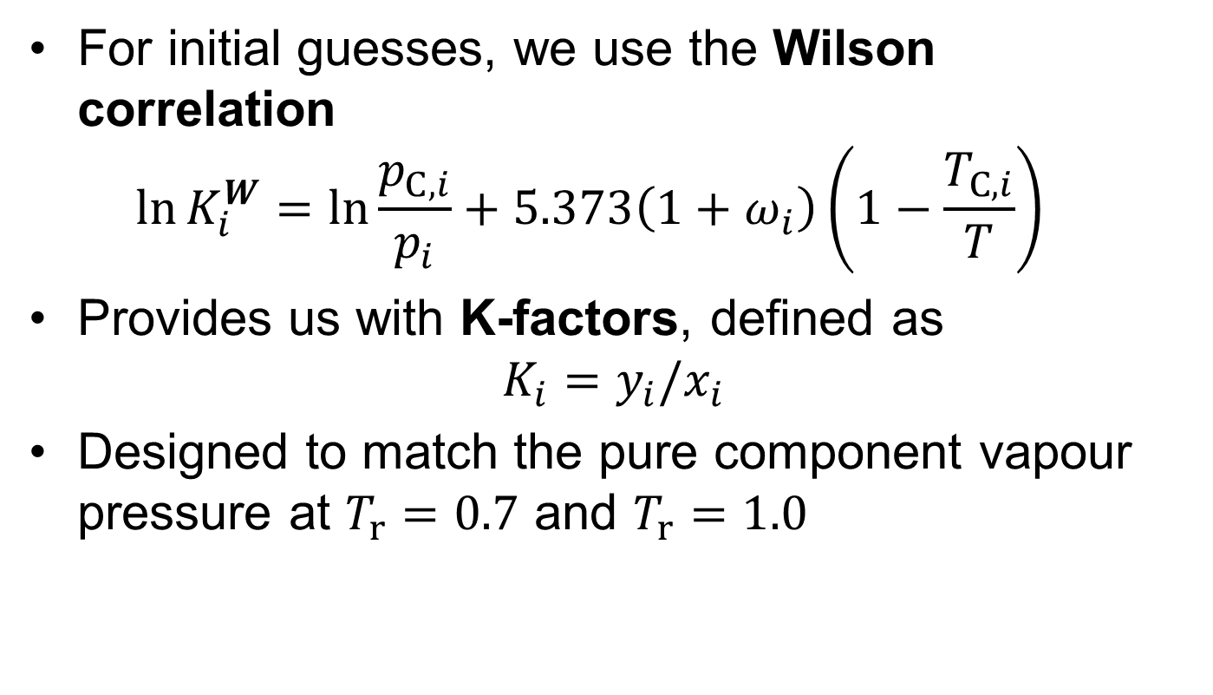
2. Initial guesses
For initial guesses, we use the Wilson correlation $\ln{K_{i}^{W}}=\ln{\frac{p_{C,i}}{p_{i}}}+5.373\left(1+ω_{i}\right)\left(1−\frac{T_{C, i}}{T}\right)$
Provides us with K-factors, defined as $K_{i}=y_{i}/x_{i}$
Designed to match the pure component vapour pressure at $T_{r}=0.7$ and $T_{r}=1.0$

Slide 24
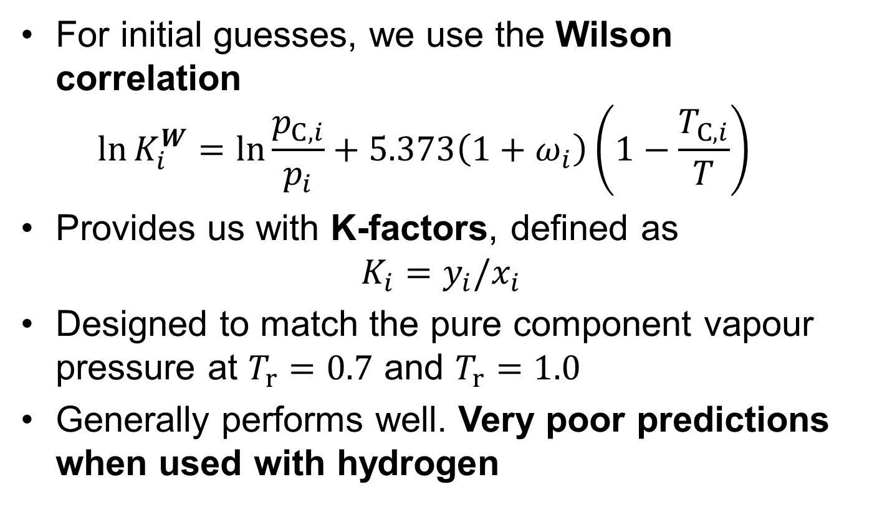
2. Initial guesses
For initial guesses, we use the Wilson correlation $\ln{K_{i}^{W}}=\ln{\frac{p_{C,i}}{p_{i}}}+5.373\left(1+ω_{i}\right)\left(1−\frac{T_{C, i}}{T}\right)$
Provides us with K-factors, defined as $K_{i}=y_{i}/x_{i}$
Designed to match the pure component vapour pressure at $T_{r}=0.7$ and $T_{r}=1.0$
Generally performs well. Very poor predictions when used with hydrogen

Slide 25

3. Minimise $tm$
To minimise our objective function, Newton’s method is highly effective

Slide 26

3. Minimise $tm$
To minimise our objective function, Newton’s method is highly effective
Because we aim to evaluate all minima of the $tm$ function we use multiple starting points

Slide 27
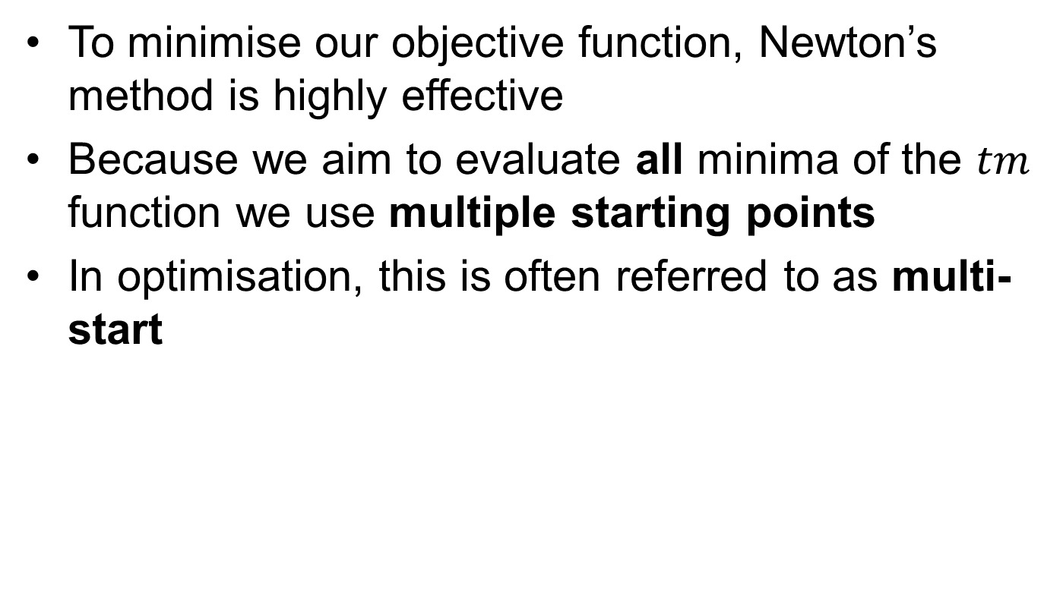
3. Minimise $tm$
To minimise our objective function, Newton’s method is highly effective
Because we aim to evaluate all minima of the $tm$ function we use multiple starting points
In optimisation, this is often referred to as multi-start

Slide 28
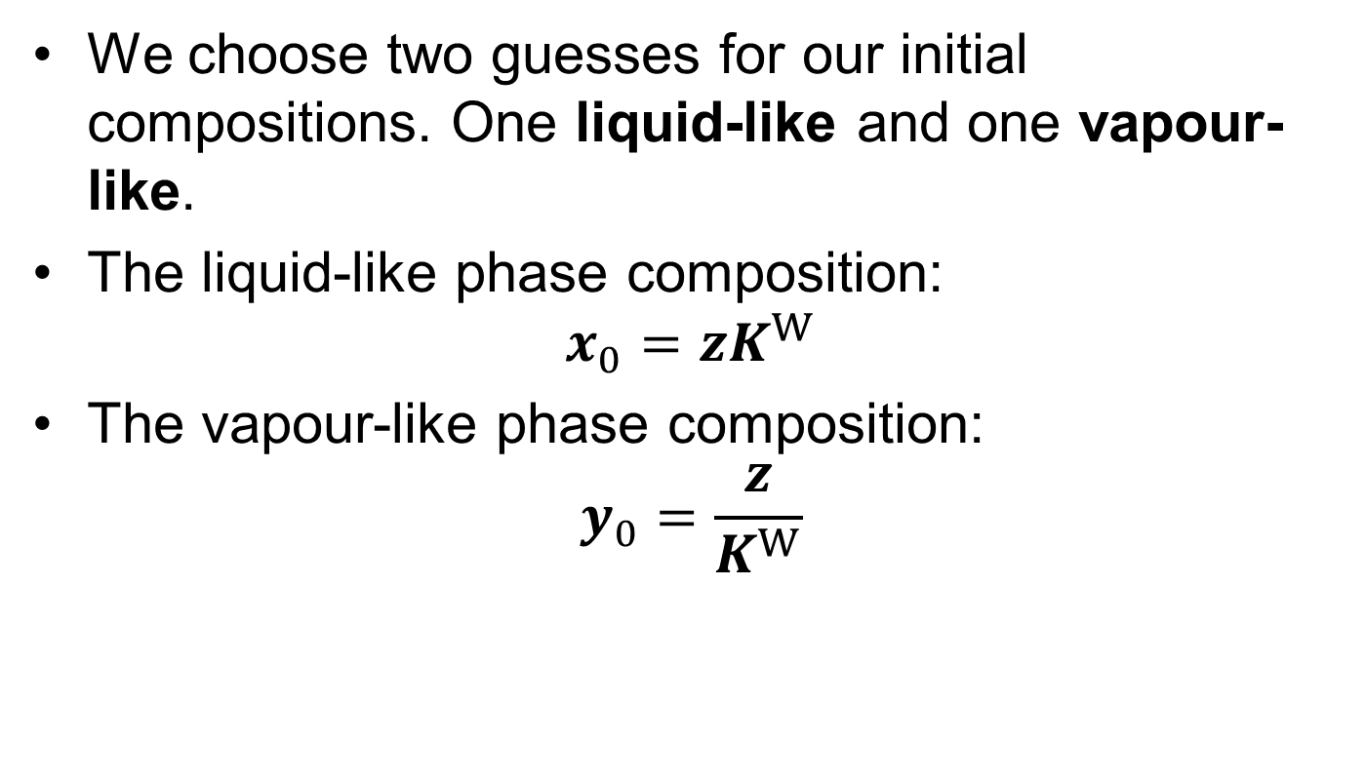
3. Minimise $tm$
We choose two guesses for our initial compositions. One liquid-like and one vapour-like.
The liquid-like phase composition: $x_{0}=zK^{W}$
The vapour-like phase composition: $y_{0}=\frac{z}{K^{W}}$

Slide 29
3. Minimise $tm$
Switch to notebook and show implementation
Notes:
# Solve for our liquid and vapour guesses
optf = OptimizationFunction(f, Optimization.AutoForwardDiff())
prob(x0) = OptimizationProblem(optf, log.(x0))
sol(x0) = solve(prob(x0), Newton())
# Evaluate solutions
sol_vec = sol.(x0_vec)

Slide 30
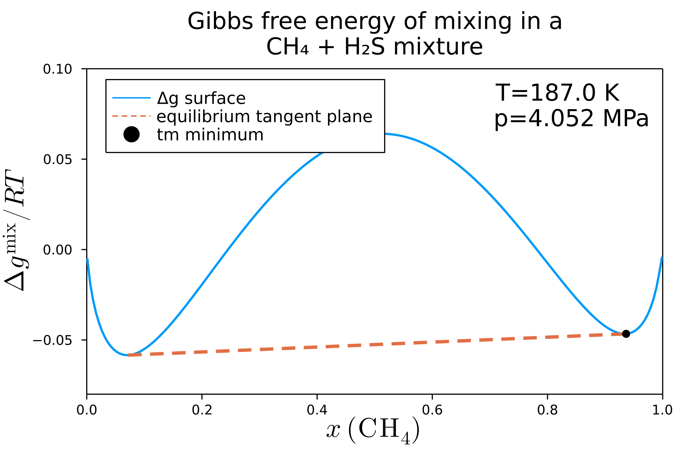
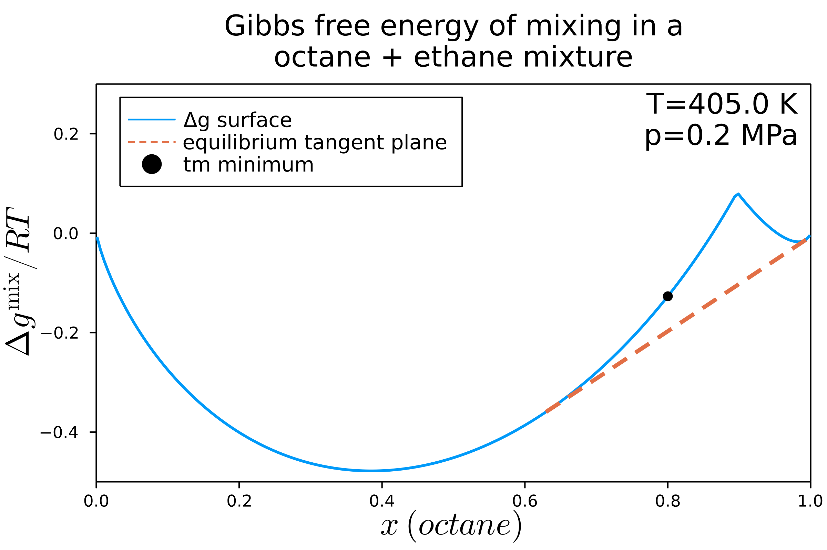
Equilibrium guesses
One of the key applications of stability analysis is providing good “guesses” of equilibrium
Notes:
These are incredibly useful when applying stability analysis as the precursor to a full flash algorithm. A flash algorithm is the terminology for the calculation of the “equilibrium tangent plane”, and will be the focus of our next section

Slide 31
Key points
When considering the Gibbs tangent plane criterion, there is only a single cotangent plane representing the equilibrium compositions
There are infinite tangent planes that can signal chemical instability
To calculate the tangent plane distance, we transform our function to an surrogate unconstrained function
Stability analysis is an important tool in its own right, as well as providing initial guesses to further calculations

